Slide 1

MarKsheet generator using java
Jayesh Patil
Yash shettigar
Amey ratnaperkhi
Dipak Zad

Slide 3
INTRODUCTION
The Marks sheet Generator System will help the user to generate a Progress Marks sheet of students. This system allows the digital automation of the mark-sheets of the students. We are able to see the individual candidate’s results separately. It will help the user to calculate the percentage of students using their marks as input data in the project. The system has been designed to carry out the mark analysis process in an educational institution being more specific this system is targeted to small enterprises, schools, colleges and universities. Marks sheet generation system can be used in universities to automate the calculation & announcement of digitally verifiable mark-sheets of students. The project aims at developing a marks sheet generation system which can be used in universities to automate the distribution of digitally verifiable student result marks sheets. To simply put, system is to provide the mark-sheet for marks based marks sheet generating system in user friendly and secure manner. The System takes input from user of student’s exam & result information and displays the total marks scored in each subjects in both (separate subjects and also total marks with percentage). The project is made up of pure coding in JAVA, HTML languages using Applet library, (Abstract Window Toolkit) AWT library etc.

Slide 4
SYSTEM REQUIREMENTS SPECIFICATION
Hardware requirements:
• 1.5 GHz Pentium 4 processor or other compatible
• 512 MB – 1 GB RAM
• Color Monitor
• Keyboard
• Mouse
Software requirements:
• Operating System : Microsoft Windows
• Application Software : JDK 1.6.0_45
JRE 6.0.450.6

Slide 5
WORKING
In the system, the user enters the student’s name & marks of each subject. That associated information will be computed or calculated in the system. In this system, all subject’s marks sum total is calculated automatically. As described in the system after the marks are entered it not only calculates their sum total , percentage but also generates a marks sheet having exam details, student details and marks, percentage scored by him/her and also shows if student is failed or pass by displaying the result in green or red. It detects the student’s result status by showing result in green if passed and showing result in red if failed by using a simple logic that if that student is failed in any one or more subject by scoring less than 41marks then the system will show the result status of that student in red which indicates fail and pass even if he/she scores just passing marks which is 41 in all subject. This information can be directly added to the original marks sheet of student or can be added to database of institute or company. After inserting student’s marks of all subjects by the user the mark sheet can be generated by clicking the “View student result” button and can be viewed by anyone. Then system generates a raw mark sheet of student or we can say processed & calculated data to be added in original marks sheet.

Slide 6
NEED OF MARKSHEET GENERATOR
Our Project is heavily inspired by all the hardworking teaching staff which manually counts the marks & percentage of students, so to make it easy and faster We have developed the Marks sheet Generator to simplify and provide the Marks sheet by just entering the students marks in just one simple click. So to ease work of our hard-working teaching staff and provide them hassle-free work, we decided to develop the project. The project aims at developing a marks sheet generator which can be used in universities to automate the distribution of digital form of student mark sheets. The Marks entered by user are then calculated by logic provided in JAVA code and generated mark sheets are printed in Applet viewer which provides the quick and faster generation of Marks sheet. We also considered the simplicity and reliability of the Project to make it easy to understand, so any one with a basic idea of computer can generate the marks sheet easily. This Project can run on any basic computer which can run JAVA, so it can almost on all computer system. The Life-Cycle of our project is unlimited so it can generate the marks sheet as long as the Code is present in the system. Even by doing future enhancement we can also provide help to those student who require urgent copy of digital marks sheet and so that they do not require to fill any application in college/school, so that it will ease off work-load of teaching staff and also student.
Targeted users:
• Students
• Teacher/Office staff

Slide 7
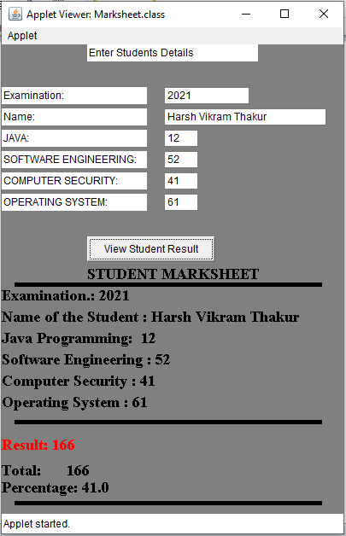
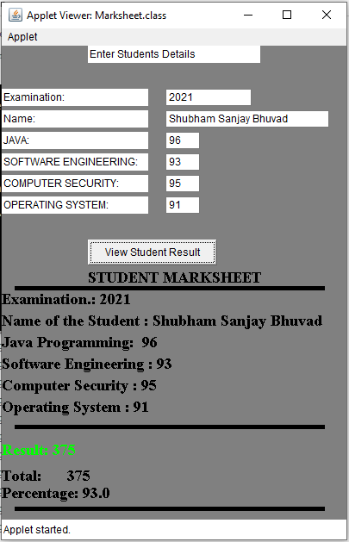
MARKSHEET GENERATOR SCREENSHOTS

Slide 8
METHODOLOGY
We have developed a System to analysis and generate marks sheet of student based on the curriculum that represent the Student academic data of student performance. Only user has to enter the Student’s Name & Subject Marks of each Subject in the system and all information provided by the user will be calculated or computed and shown in one system. Benefit of this system is it collects or pursue all data regarding marks from Data Provided by user and shows on one platform and when all the provided information by student is calculated it also shows the percentage of student depending on information provided by user. This system is developed with the help given software: JDK 1.6.0_45, JRE 6.0.450.6
We have created a program or codding required for Developing or creating a system on our basic Notepad present on the window while developing the codding for the program we have used several Packages like Java, applet, awt.event, html code, etc. for Running / Executing. We have used basic command Compiler and then we have enter the path in command prompt for executing our System and after entering the path with the help of applet viewer the System is generated successfully on applet viewer. After executing the System on applet viewer user has to enter the Examination year in Examination, Name in the Name Box and Equivalent marks of student score by him them press the “View Student Result” button and all information will appear in the “Student Marks sheet” column user will appear Examination Marks, Student Name, Student’s Marks and at bottom Percentage is also calculated on the basis of information given by user.

Slide 9
ADVANTAGES & DISADVANTAGES
ADVANTAGES
• User-Friendly (as user can easily use marks sheet generator as it has simple GUI created using applet, AWT).
• Requires less effort and time for calculations therefore error free.
• Unlimited life-cycle(system remains available as long as code remains in the computer system)
• Requires less computing storage & can run in low spec computer system that can run java.
• It is fast and accurate with calculations & computations can generate the marks sheet quickly.
DISADVANTAGES
• Future- enhancement is required as it does very few operations and displays a single small window.
• No security is available & has single user access, so it can be easily misused or is very less useful in real time applications.
• System doesn’t stores the data, as it has no database or isn’t connected to one.
• System only calculates percentage, sum and display them which can also be done on calculator or other applications.
• It has “java” file instead of “exe” file, therefore the source code can be modified.

Slide 10
CONCLUSION
The goal of the system is achieved and difficulties are solved. The project is built such that it is user friendly. Analysis of the scoring system it shows by the grade wise result of individual subject and final result also display grade wise depending on its range of marks. The project can be easily used in college for college result analysis of student. It reduces time which required for manual calculation. This system helps to calculate result fast so it optimizes the manpower. The Marks sheet Generator System will help the user to generate a Progress Marks sheet of students. We are able to see the individual candidate’s results separately. It will help the user to calculate the percentage of students using their marks as input data in the project. This system allows the digital automation of the mark-sheets of the students. The System takes input from user of student’s exam & result information and displays the total marks scored in each subjects in both (separate subjects and also total marks with percentage). The project is made up of pure coding in JAVA, HTML languages using Applet library, (Abstract Window Toolkit) AWT library etc. The system has been designed to carry out the mark analysis process in an educational institution being more specific this system is targeted to small enterprises, schools, colleges and universities. Marks sheet generation system can be used in universities to automate the calculation & announcement of digitally verifiable mark-sheets of students. The project aims at developing a marks sheet generation system which can be used in universities to automate the distribution of digitally verifiable student result marks sheets. To simply put, system is to provide the mark-sheet for marks based marks sheet generating system in user friendly and secure manner.

Slide 11

Thank You

